Slide 1

Predictive Models - Midterm Project
Objective
Propose values for theta to the engineers, which will increase the time spent by the user on the video app.
Verify how auxiliary variables such as Aux1 and Aux2 affect time spent feature

Slide 2
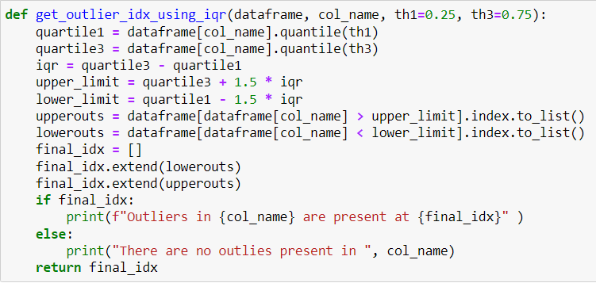
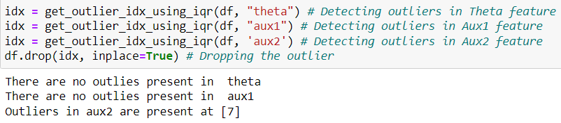
Part1: Prepare the data Dropping the outliers

Slide 3
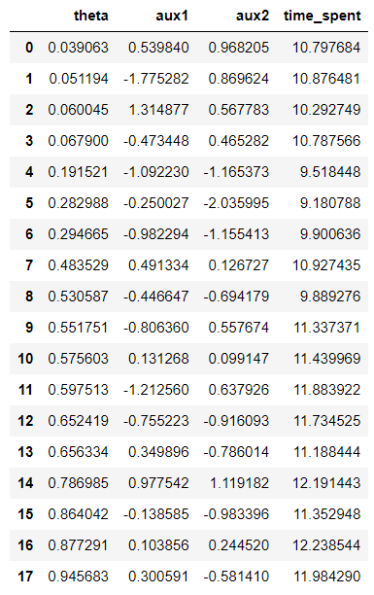
Final dataset

Slide 4
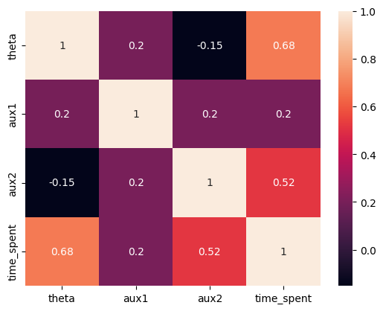
Correlation between the variables

Slide 5
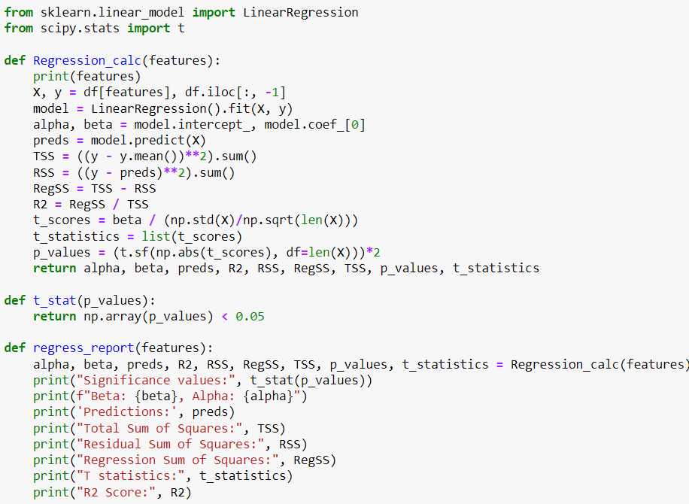
2. Model Building

Slide 6
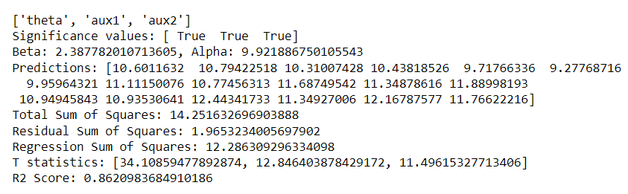
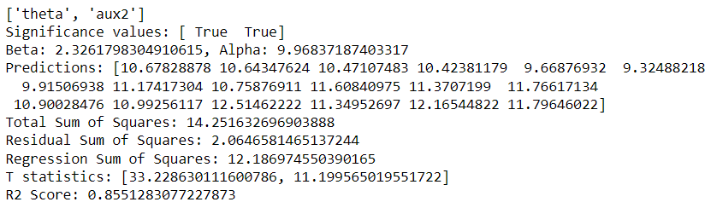
Selecting the best parameter combinations for the final model
Model 1
Model 2
I chose model 2 as the difference is 0.007, and the model complexity can be reduced.

Slide 7
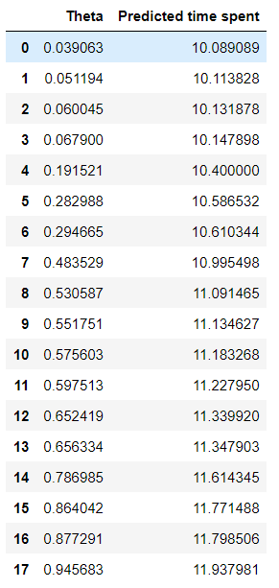
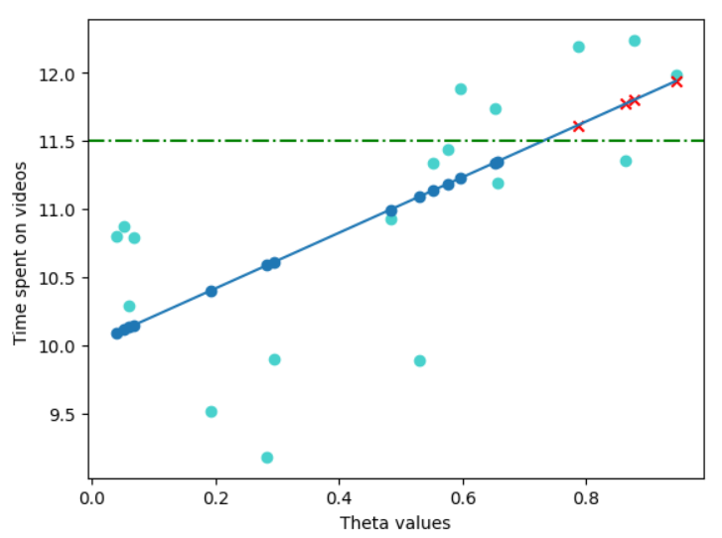
3. Proposing the values for Theta
It can be observed as the Theta values increase the time spent values also increase.
I propose 0.786985, 0.864042, 0.877291, and 0.945683 values for theta.

Slide 8
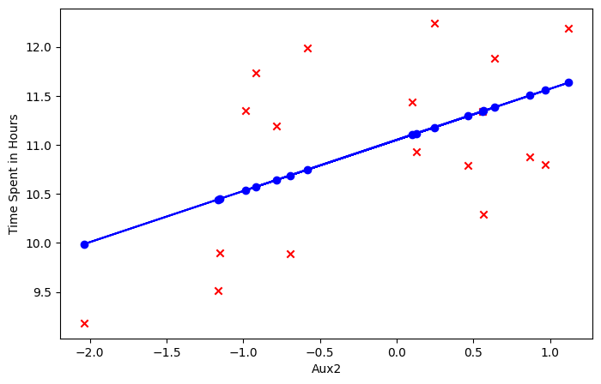
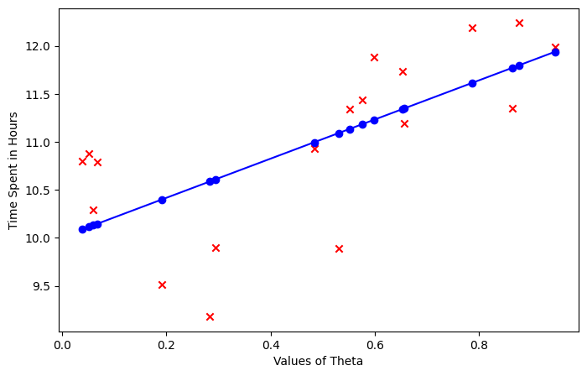
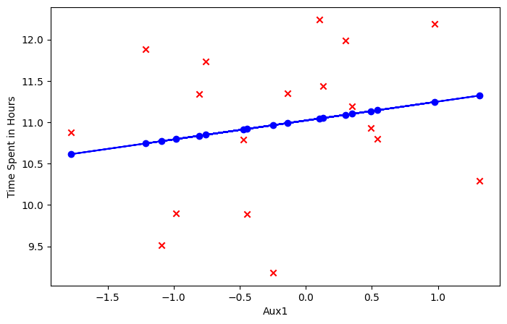
4. Experimental or observational Theta vs rest plots
The problem statement is observational as the startup is trying to find out how the values of theta, aux1, and aux2 are affecting the customer’s time spent on the videos. To qualify it as the experimental dataset, we must propose new data, use experimental methods, and find if the results are replicable.

Slide 9
Any questions?

